Slide 1
Navigating Ecommerce
GYN/Organoid Ordering

Slide 2
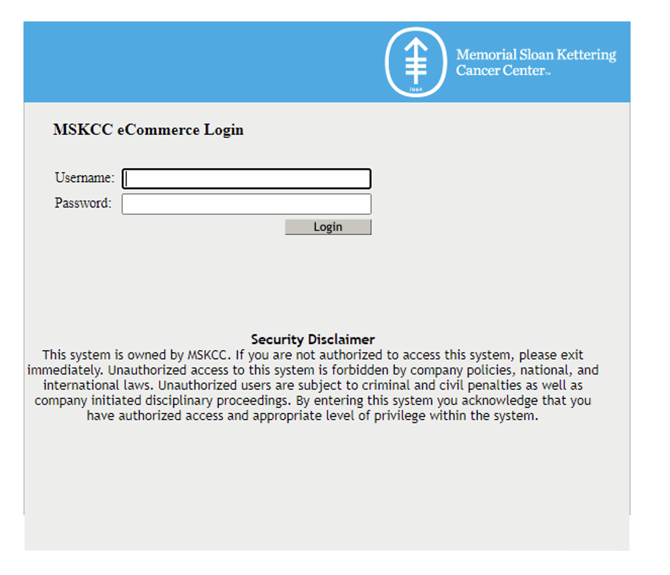
Ecommerce Login
Navigate to the MSK Ecommerce portal through OneMSK
Log in using your normal MSK credentials

Slide 3
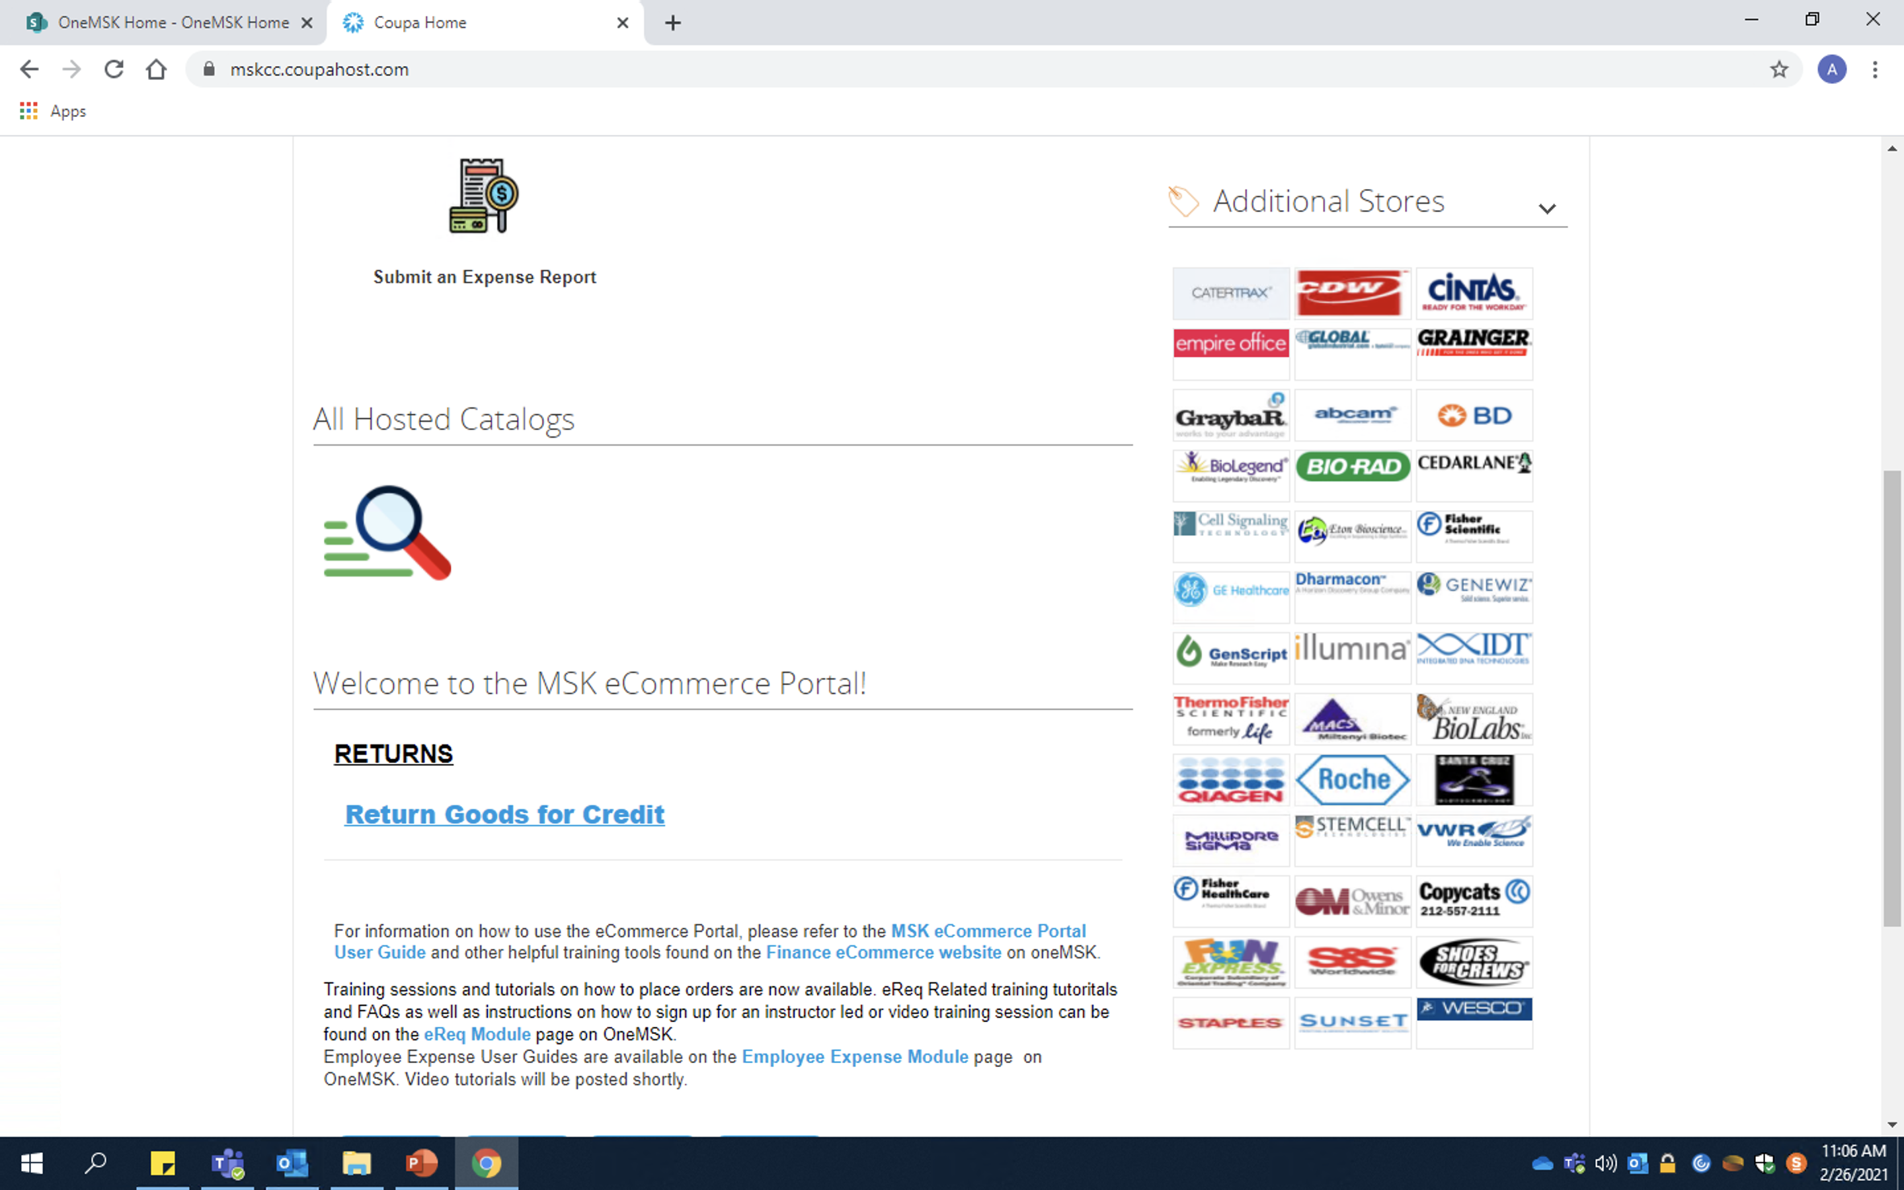
Ecommerce Home Page
Most common store links
– ThermoFrisher
– QiaGen
– Millapore Sigma (Sigma-Aldrich)
– Fisher Healthcare/Scientific
– Staples

Slide 4
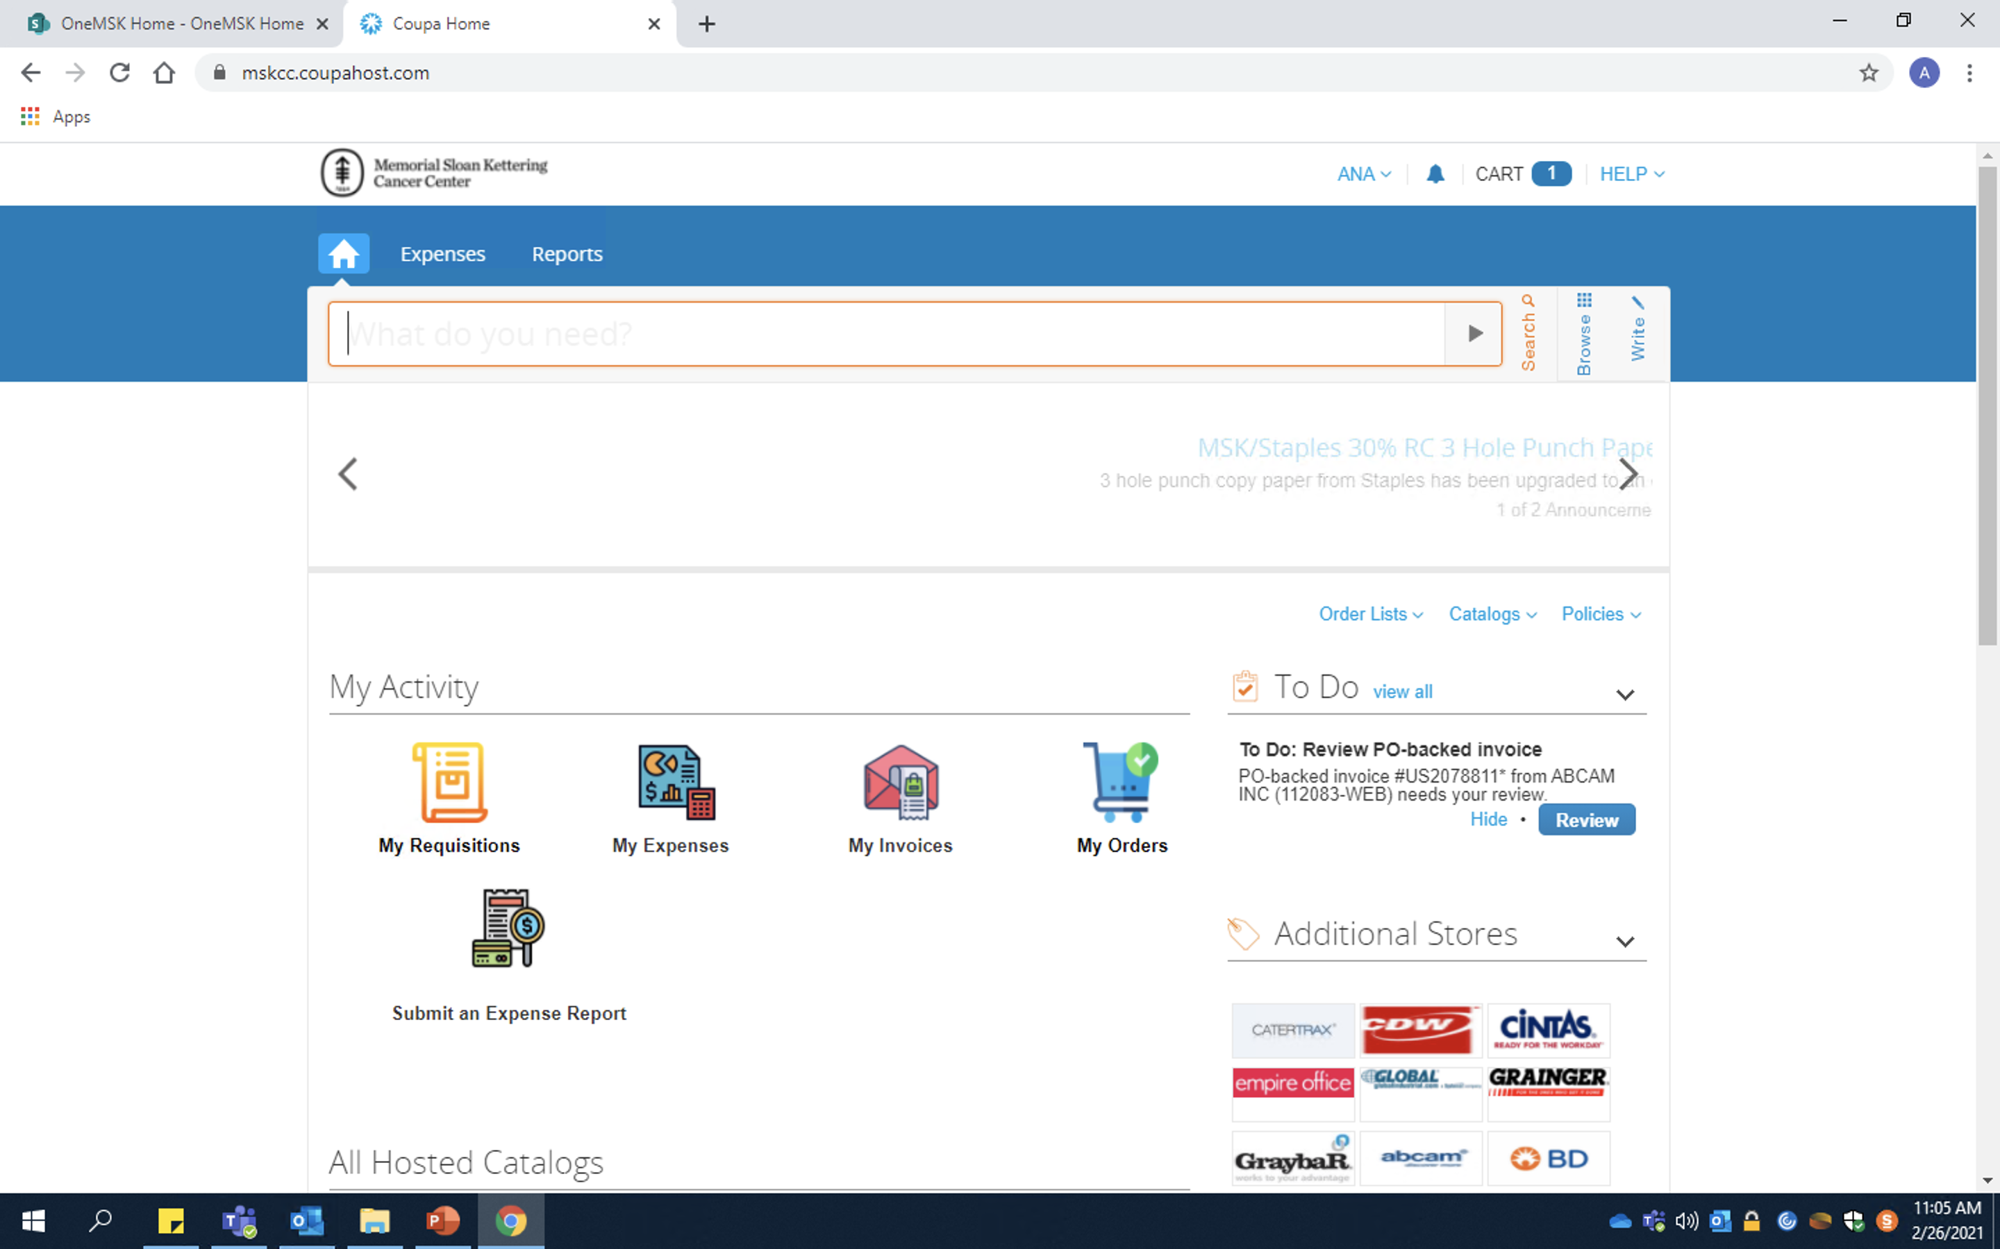
Search: Can search for items by name or by catalog number. Useful if you don’t know what store to order from
Ecommerce Home Page
Cart: Navigate or hover mouse here to review what items are in your cart
Write: Navigate here when an off-catalog order is required
Catalogs: Search here for in-catalog stores that do not appear in the fast links below

Slide 5
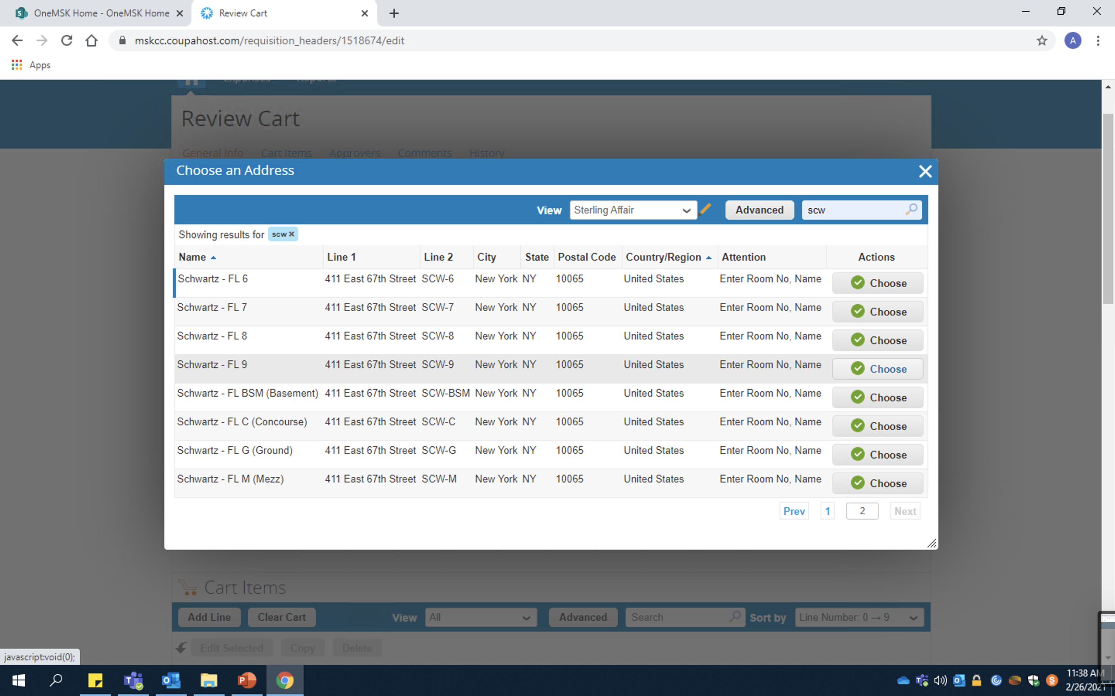
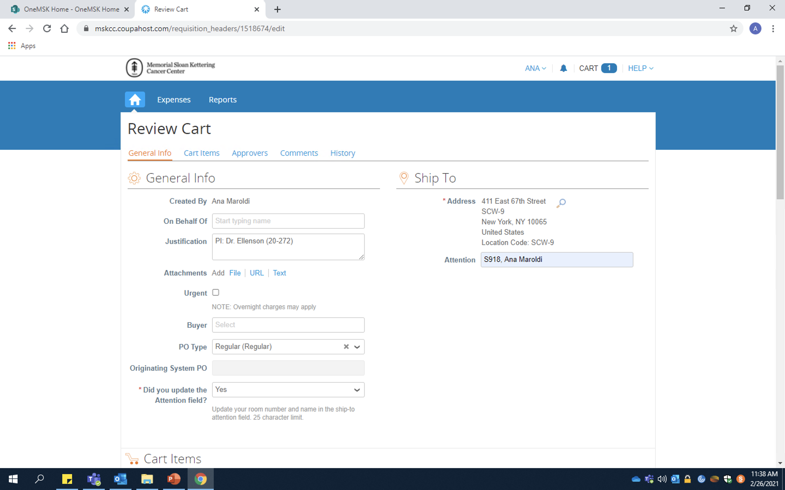
In-Catalog Orders
Navigate to the search icon, type “scw” for Schwartz into the search bar (top right) and find “Schwartz – FL 9” on the second page
Be sure to update the attention field with our room number and name (S918, name)

Slide 6
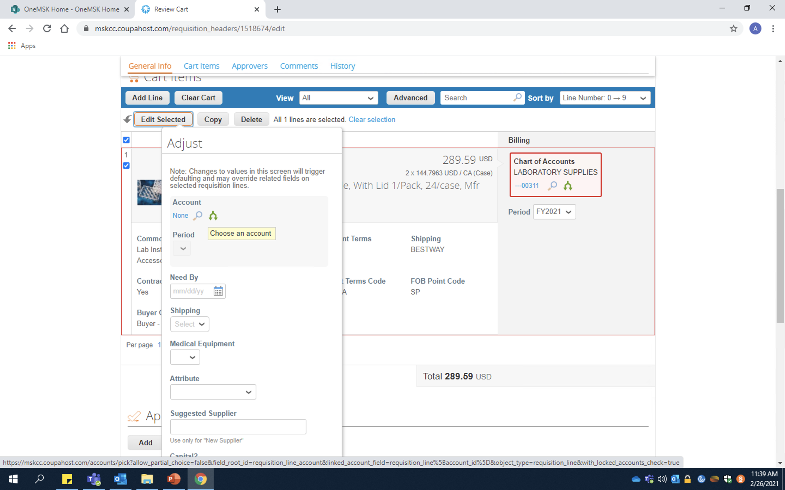
In-Catalog Orders
Highlight all items in your cart and click “Edit Selected”
Click the blue search button underneath the “Account” section
Note: Do not try to find the account without using the search icon – it won’t work

Slide 7
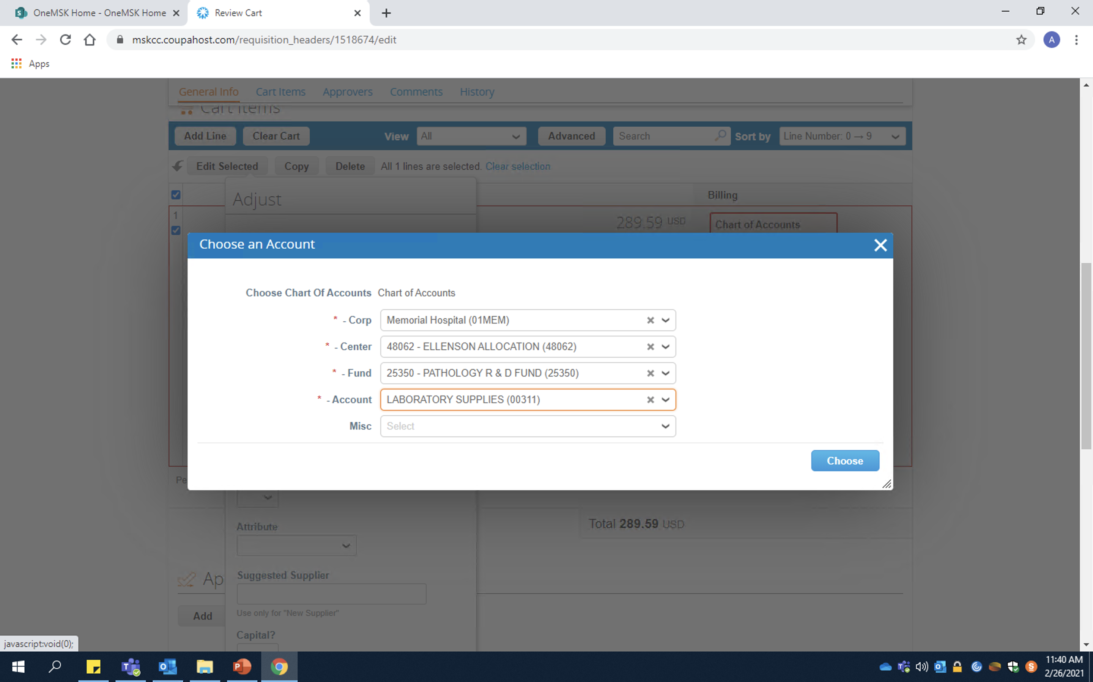
In-Catalog Orders
Corp: Will usually be either “Memorial Hospital (01MEM) or Sloan Kettering Institute (01SKI)
Note: If unsure what corporation to use, follow these guidelines:
01MEM: 00000 → 49980
01SKI: 50001 → 59980
Center/Cost Center: The first set of numbers provided by your PI
Fund/Fund number: The second set of numbers provided by your PI
Note: Sometimes a cost center will have multiple fund numbers. Be sure you are selecting the correct one!
Account: Provides basic description of items being ordered. I usually use either:
00311: Lab supplies
00340: Chemical

Slide 8
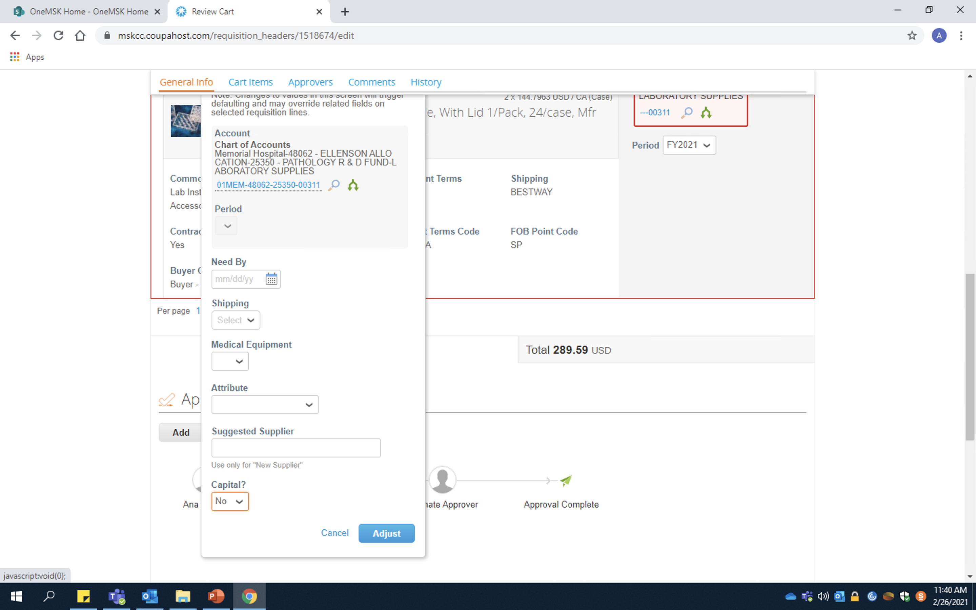
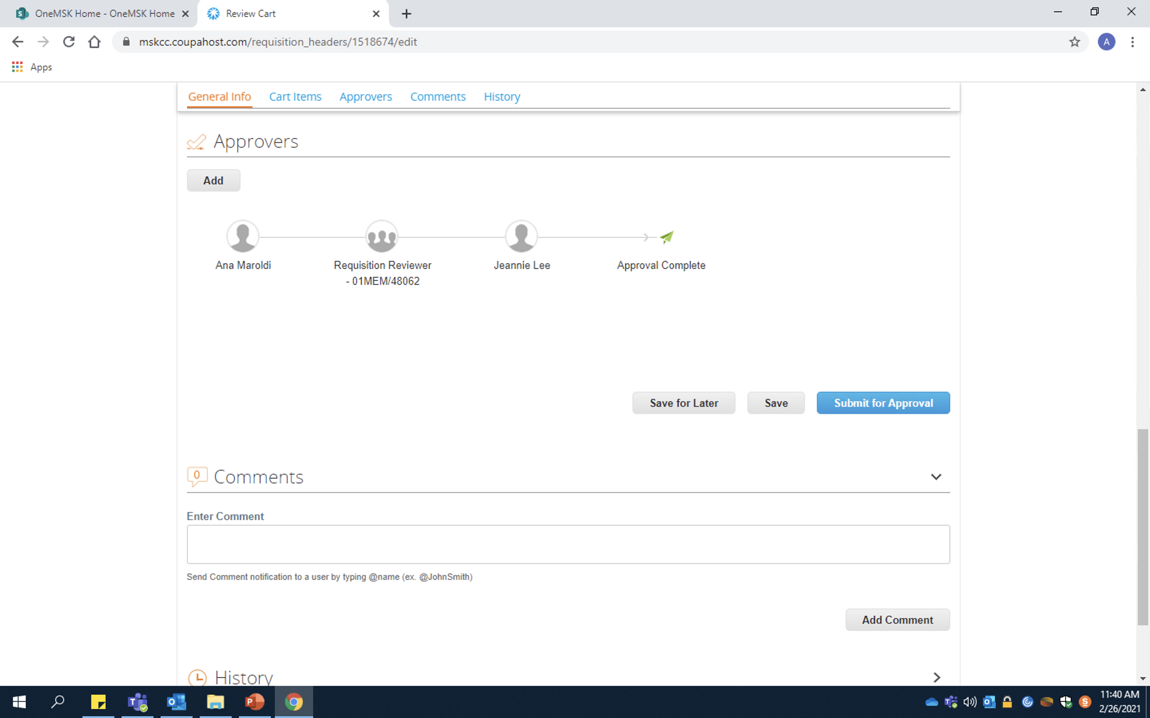
In-Catalog Orders
Indicate this order is not considered Capital
Review all order details then press “Submit for Approval”
DONE !!
Click “Adjust” to save all changes

Slide 9
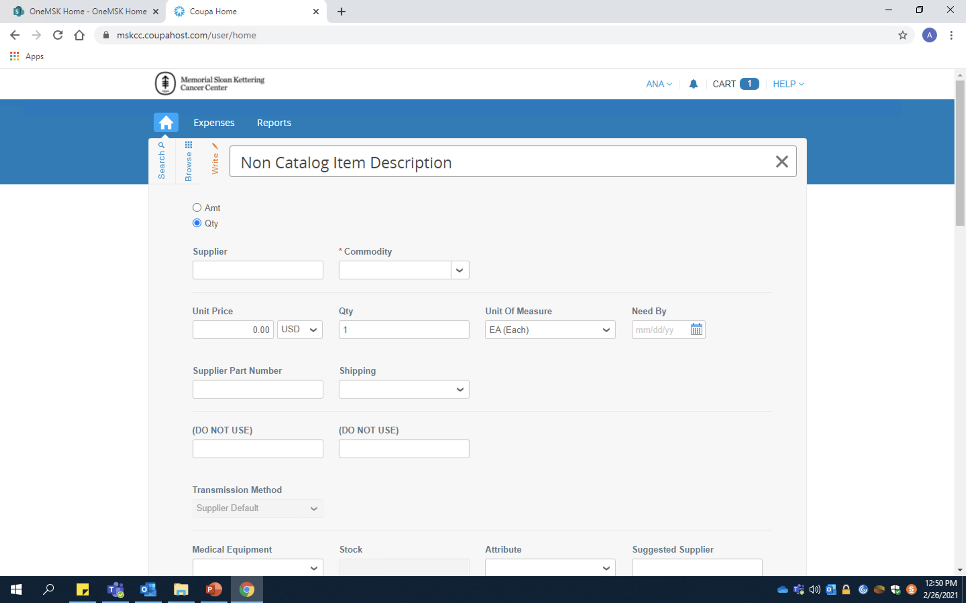
Off-Catalog Orders
If, after pulling out all the stops, you still cannot find the catalog/cat. number you need – you’re probably dealing with an “off-catalog” store request. (RIP)
If possible, it is best to avoid doing off-catalog orders. See if it can be ordered through an in-catalog third party (Usually Fisher or Sigma). However, sometimes items are dramatically more expensive when coming from a third party store. In these cases, talk to the person who needs the item and decide what is best.
NOTE: Off-catalog order requests CANNOT be submitted with in-catalog orders. They MUST be submitted separately.

Slide 10
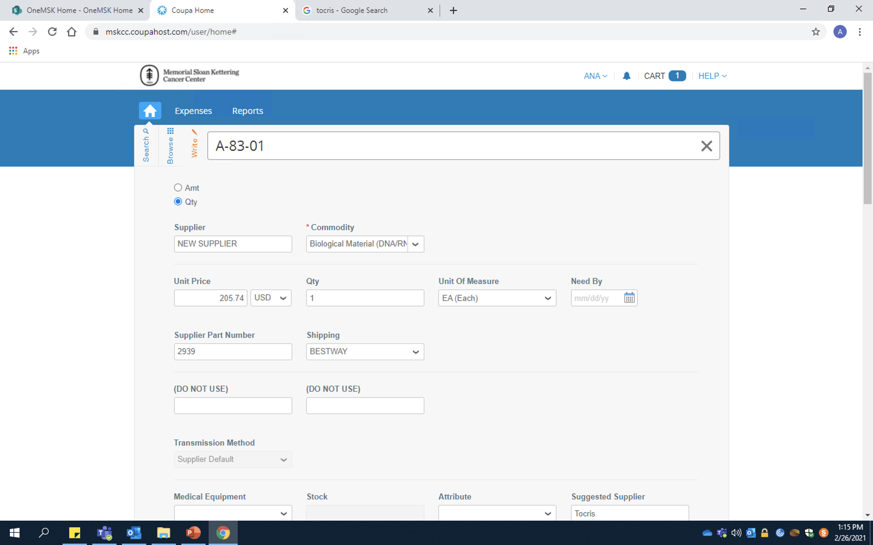
Off-Catalog Orders
Item Description: Place the name of the item as listed in Ziggy/order sheet
Supplier: Every “true” off-catalog will not appear in the supplier drop down. Must select “New Supplier”
Commodity: General category description of item
Unit Price: Pretty Self explanatory. Make sure to edit the quantity and currency if needed
Supplier Part Number: Also known as catalog number

Slide 11
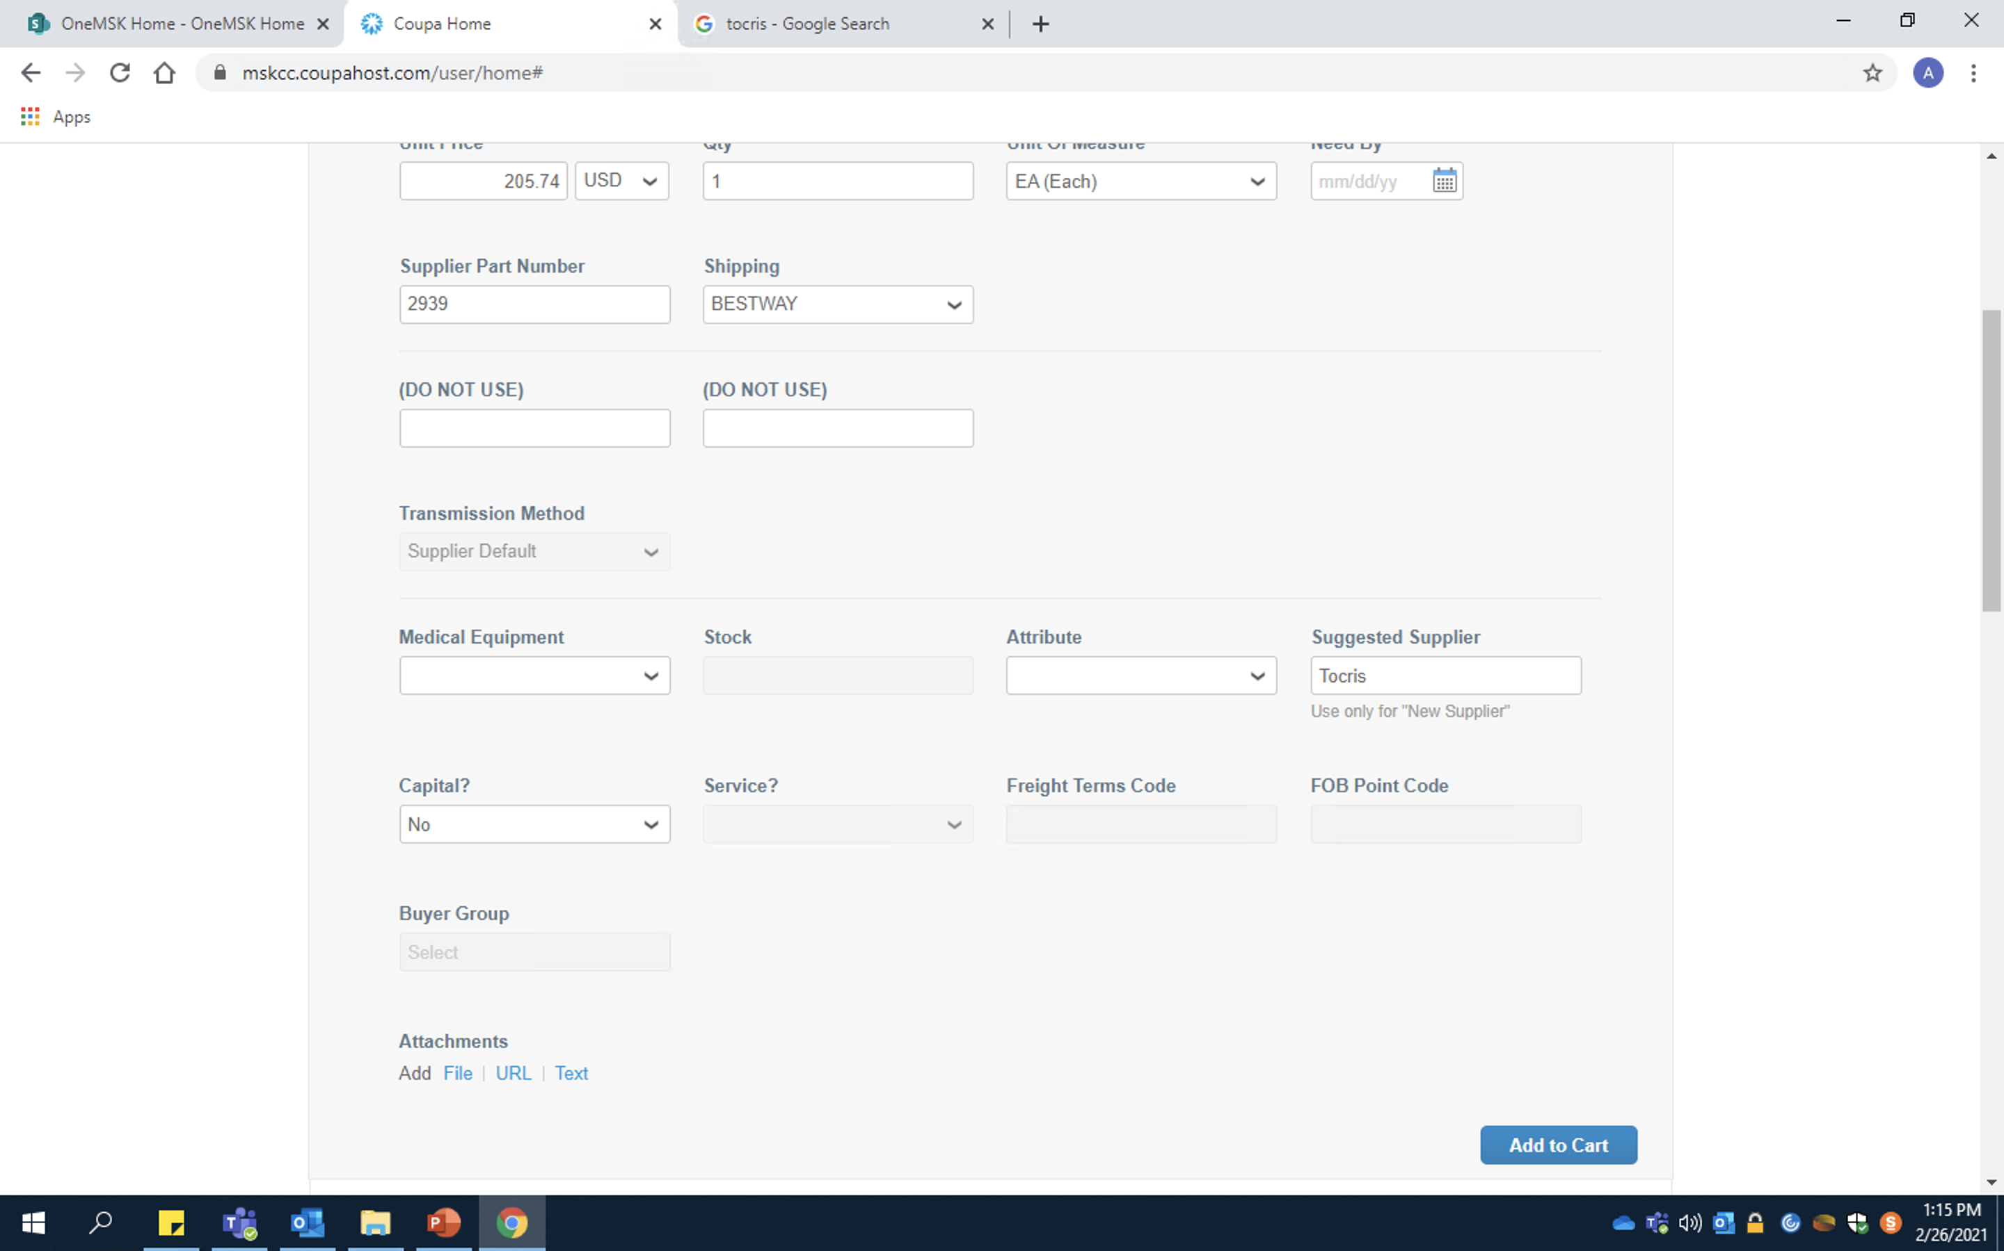
Off-Catalog Orders
Capital: Same as in-catalog orders. Only needed for very large, expensive orders
Suggested Supplier: This is where you indicate the actual name of the off-catalog supplier

Slide 12
The End

